Slide 1

HEALTHCARE ANALYTICS FOR DOCTOR VISITS
NAME : LOGADHARSHINI K
ACITE STU ID: STU6569925aaf23d1701417562

Slide 2

PROBLEM STATEMENT
Healthcare data contains valuable information about patients' health conditions and their use of medical services. However, analyzing this information manually can make it difficult to identify patterns and relationships.
The objective of this project is to analyze doctor-visit data using Python to understand how factors such as illness count, age, gender, income, health status, and healthcare coverage are associated with the number of doctor visits.
The project aims to transform raw healthcare data into meaningful insights through data cleaning, exploratory data analysis, statistical summaries, and data visualization.

Slide 3
Project Description
Healthcare Analytics for Doctor Visits is a data analytics project developed using Python. The project uses a dataset containing 5,190 records and 13 original columns related to doctor visits, demographic characteristics, illness, health status, income, and healthcare coverage.
The dataset is processed using Pandas and NumPy to inspect the data, check data quality, and calculate summary statistics. Matplotlib and Seaborn are used to visualize doctor-visit distributions and explore relationships between visits and other variables.
The analysis focuses on identifying patterns in healthcare utilization, comparing groups, and presenting meaningful findings that can support further healthcare research and planning.

Slide 4

WHO ARE THE END USERS?
1. Healthcare Administrators
2. Healthcare Researchers
3. Public Health Analysts
4. Data Analysts and Students

Slide 5

Technology Used
Python
Pandas
NumPy
Matplotlib
Seaborn
Visual Studio
CSV

Slide 6
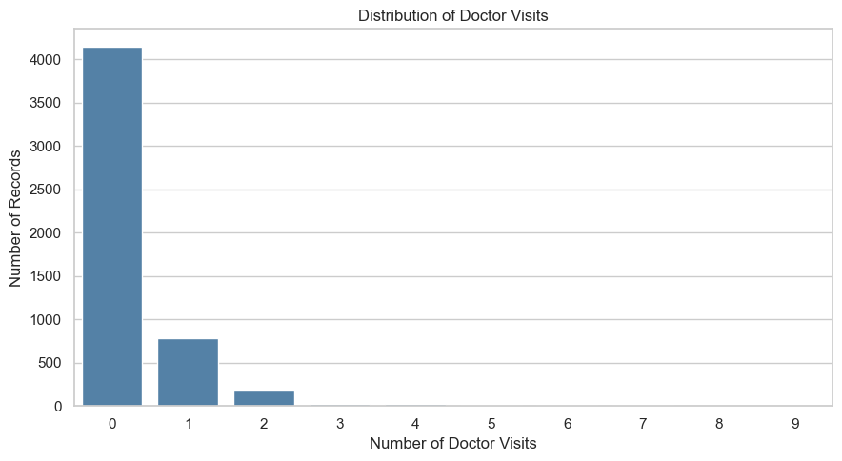
RESULTS
The chart shows that most records have zero doctor visits, while a smaller number have one or two visits. Very few records have three or more visits. This indicates that doctor visits are concentrated at zero, resulting in a highly skewed distribution.

Slide 7
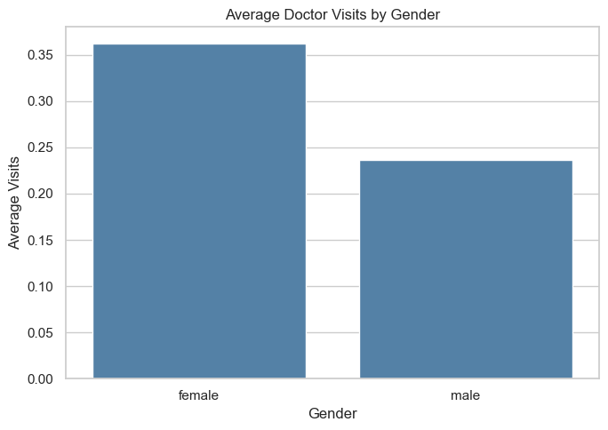
RESULTS
The chart shows that female records have a higher average number of doctor visits (approximately 0.36) than male records (approximately 0.24). This indicates a difference in healthcare utilization between the two gender groups in the dataset.

Slide 8
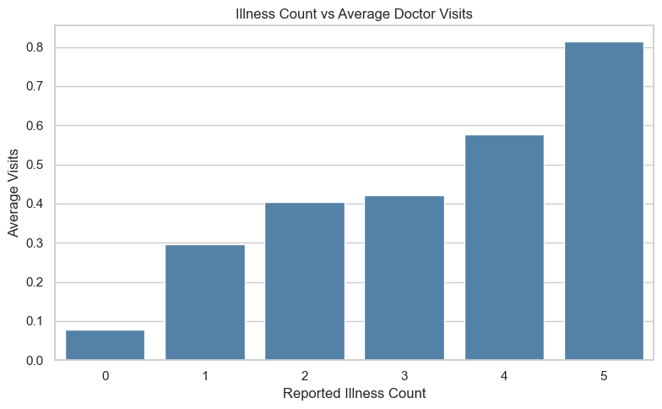
RESULTS
Doctor visits generally increase as the number of reported illnesses rises.

Slide 9
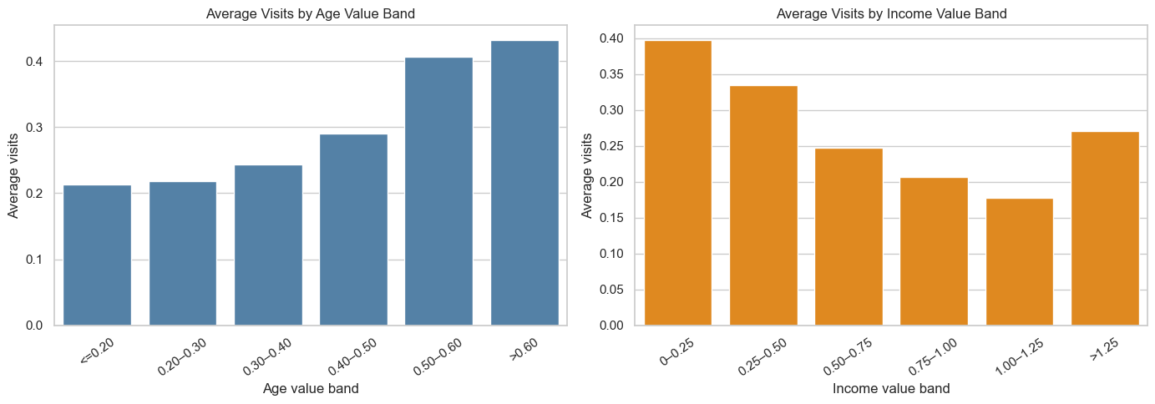
RESULTS
Average doctor visits increase with age value, while visits generally decrease as income increases, with a slight rise in the highest income group.

Slide 10
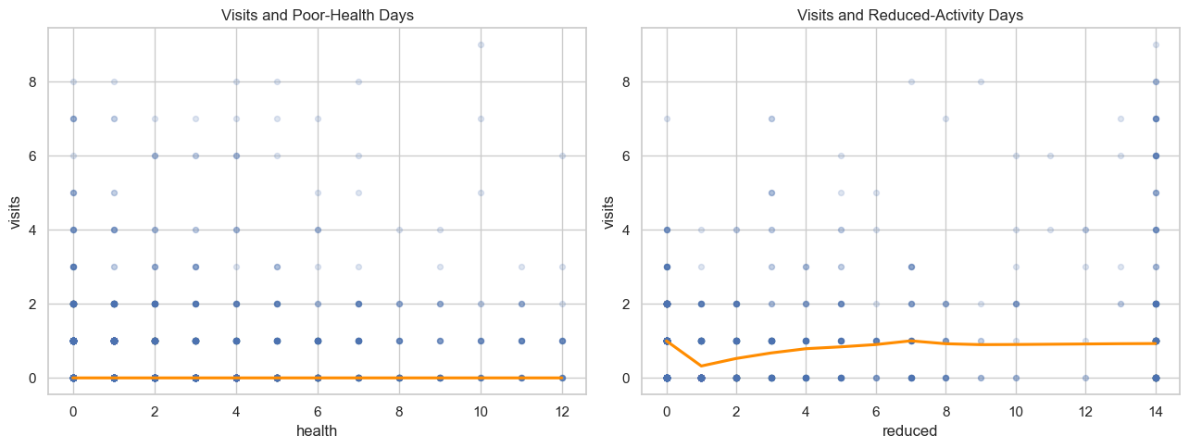
RESULTS
Doctor visits show a slight positive relationship with reduced-activity days, while the relationship with poor-health days appears weak.

Slide 11
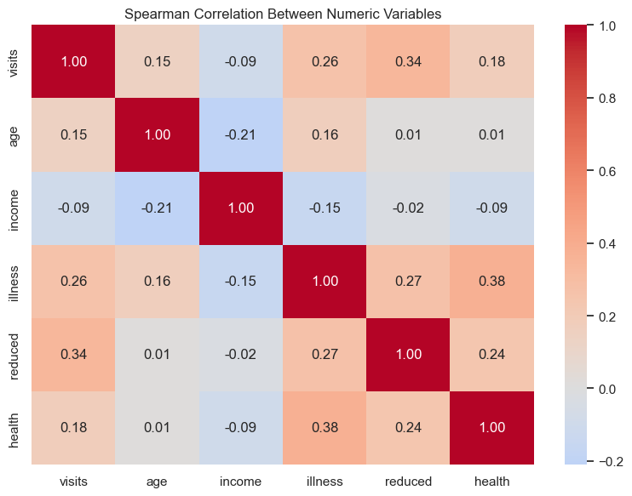
RESULTS
The heatmap shows that reduced-activity days (0.34) and illness count (0.26) have the strongest positive correlations with doctor visits, while income has a weak negative correlation (-0.09).
https://github.com/Logadharshinik004/Healthcare_Doctor_visits_analytics

Slide 12
Thank you
.
.

